Slide 1
IBM University Engagement Project Submission
“Exploring the Power of Agentic AI with IBM Granite and watsonx Orchestrate”

Slide 2
Project Tile – Interview Trainer Agent
Domain of Project – Education
Student Name | Recent Passport Photo | Email ID | Mobile number [WhatsApp]
NILEENA SAJI |  | nileenasaji1@gmail.com | 9072237555

Slide 3
Problem Statement: Interview Trainer Agent
The Challenge
Most people preparing for a job interview end up Googling the same generic question lists everyone else uses. There's no one checking their answers, no way to know what they're actually missing, and the useful stuff — real technical explanations, behavioral tips, what interviewers actually look for — is scattered across dozens of random blog posts and YouTube videos. So candidates either over-prepare on the wrong things or walk in not knowing where their weak spots are.
The Objective
Build an AI interview coach that actually acts like one — not just a list of questions, but something a candidate can practice with. It should:
- Generate Practice Questions – technical and behavioral questions matched to the role they're applying for, not a generic list.
- Ground Its Answers in Real Content – pull from curated, role-specific interview material instead of making things up.
- Give Feedback on Practice Answers – let candidates type out their own answer and get told honestly what's missing.
- Explain Concepts Clearly – break down technical topics the way an interviewer would expect someone to understand them.
- Work Across Multiple Capabilities –
Generating questions
Reviewing mock answers
Explaining concepts
Giving practical tips
- Be Easy to Extend – new roles and content can be added later without rebuilding the whole agent.

Slide 4
Proposed Solution: Agentic Interview Trainer
We're building an AI interview coach using IBM watsonx Orchestrate, watsonx.ai, and Granite models — something candidates can actually practice with, not just a static FAQ page.
The core idea is Retrieval-Augmented Generation (RAG), which Orchestrate handles natively. Instead of the model guessing at answers, it first pulls relevant content from a curated knowledge base of interview material, then generates its response grounded in that — so the coaching is based on real, role-specific content rather than whatever the model happens to remember.
The agent handles four things:
Question Generation comes up with technical and behavioral questions matched to whatever role the candidate is preparing for.
Mock Answer Feedback takes a candidate's actual answer attempt and tells them honestly what worked and what didn't.
Concept Explanation walks through a tricky technical topic the way an interviewer would expect it to be understood, not just a textbook definition.
Practical Tips gives specific, useful advice instead of generic "just be confident" filler.
Everything runs inside watsonx Orchestrate's built-in chat — candidates can use it directly, or through Slack/Teams if that's easier, without us needing to build and maintain a separate app.
Orchestrate handles the agent itself (behavior, knowledge, skills), watsonx.ai takes care of model access and governance behind the scenes, and Granite is what's actually doing the reasoning, question generation, and feedback.
End result: a candidate gets something closer to a real mock interviewer than a static prep sheet — personalized, grounded in real content, and useful immediately.

Slide 5
Technology Used
- watsonx Orchestrate – This is where the actual agent lives. It's a no-code platform, so building the behavior, hooking up the knowledge base, and wiring up skills all happens without writing backend code.
- IBM Granite model – specifically granite-3-8b-instruct. This is what's doing the actual thinking: understanding what the candidate is asking, reasoning through it, and personalizing the response.
- IBM Cloud – the underlying infrastructure everything runs on. We're using the Lite (free) tier, so it's a reliable, secure environment without needing paid infrastructure.
- RAG – rather than letting the model just generate answers from memory, we fetch real interview content first, then generate a response grounded in that. Makes the coaching trustworthy instead of made-up.
- IBM watsonx.ai – handles model access and governance behind the scenes, so we're not managing that infrastructure ourselves.
- Knowledge Base – built into Orchestrate directly, so there's no separate vector database to set up and maintain. We just upload the interview content and it handles retrieval.

Slide 6
watsonx Orchestrate components used -
1) Chat Interface – the built-in Orchestrate chat window where candidates type in their role, ask a question, or paste in a mock answer.
2) Agent Behavior/Instructions – this is basically the agent's personality and rulebook. It tells the model to act like an interview coach and defines how it should respond, and Granite is what actually processes it.
3) Granite model used – Granite-3-8B-Instruct. We picked this one because it's fast and efficient enough for real-time back-and-forth coaching.
4) Agent Response – whatever the agent generates gets displayed here: questions, feedback, explanations, tips, depending on what was asked.
5) Knowledge Base – this is where the curated interview content lives (one file per role — software engineer, data analyst, etc.), and it's what the agent pulls from to ground its answers instead of guessing.
6) Actions/Skills – left as an optional slot for later, in case we want to plug in something like resume parsing down the line.

Slide 7
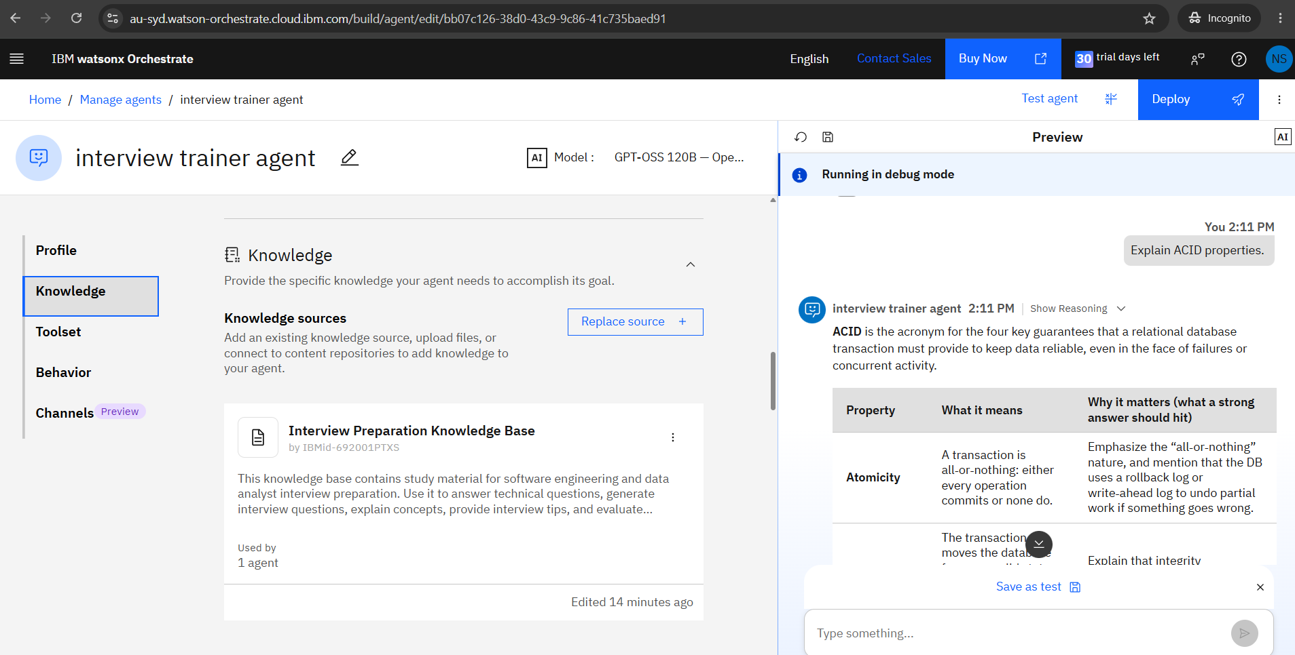
IBM watsonx Orchestrate – Interview Trainer Agent
Developed an AI Interview Trainer Agent using IBM watsonx Orchestrate.
Configured custom agent behavior for interview preparation and feedback.
Integrated a knowledge base for Software Engineering and Data Analyst interview content.
Successfully tested the agent in Preview mode by explaining ACID properties.

Slide 8
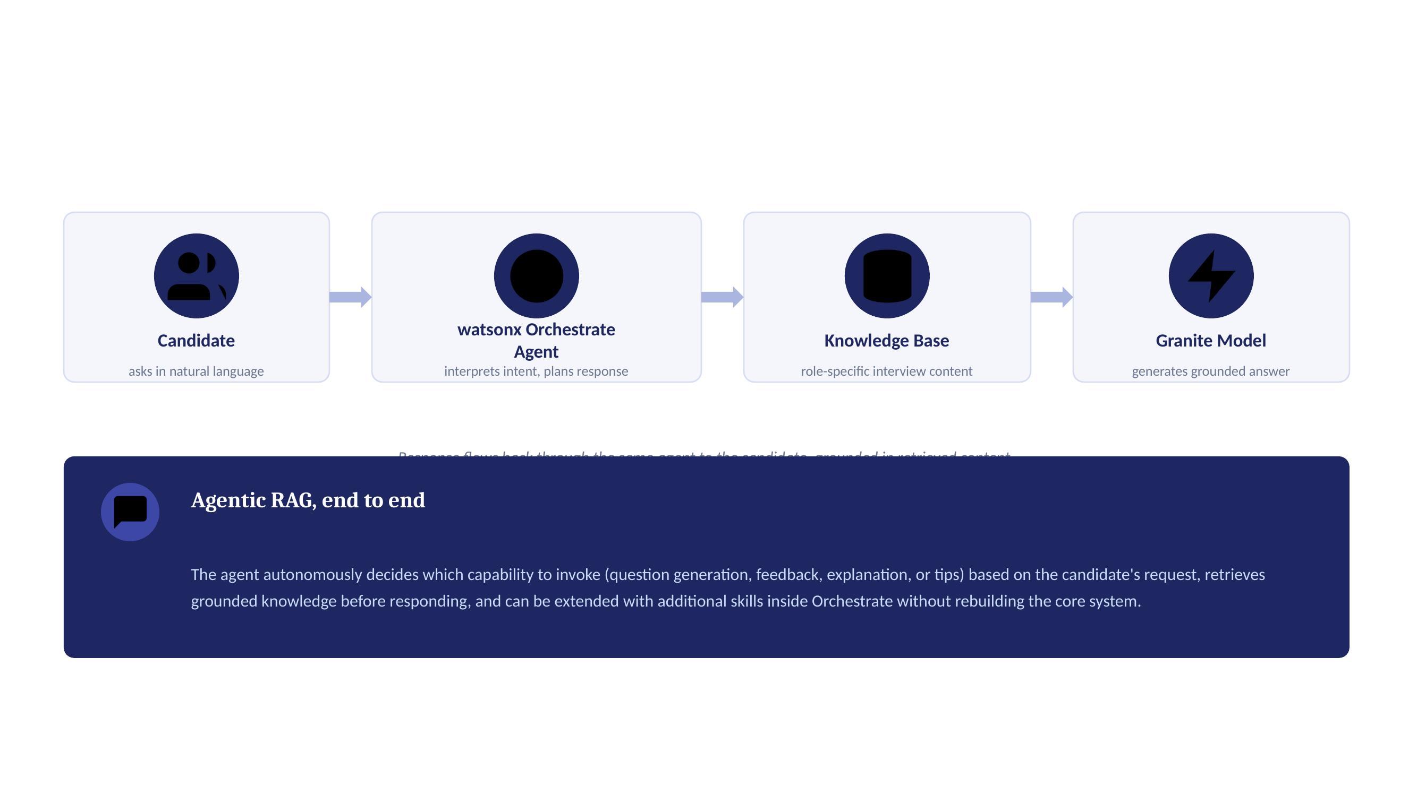
Architecture blueprint

Slide 9

Role of Agentic AI in the interview trainer agent
What makes this different from a regular chatbot is that the agent isn't just responding to whatever you type — it's actually deciding what to do. Using watsonx Orchestrate and Granite, it figures out on its own whether you're asking for practice questions, submitting an answer for feedback, wanting a concept explained, or just looking for tips, and it handles each of those differently.
So depending on what you ask, it might generate a fresh set of questions, evaluate something you wrote, or explain a topic — but all of it comes from the same grounded knowledge base, so the quality doesn't drop depending on what you're asking for.
It also pays attention to context — what role you're targeting, roughly what level you're at — so the questions and feedback actually match your situation instead of being generic. And it adapts in real time based on what you type back, so a follow-up question gets a response that builds on what you already said.
On top of that, the knowledge base can grow over time — add a new role's content, and the agent can immediately coach for it, no rebuild needed.
Basically, the agentic part is what turns this from "a chatbot that knows about interviews" into something that behaves more like an actual coach — proactive, aware of who it's talking to, and working toward getting you ready for the interview.

Slide 10
Novelty and Uniqueness
What makes this different is that it's not just another chatbot with an interview theme — it's Agentic AI, RAG, and personalization actually working together.
Agentic Task Routing – The agent figures out on its own whether you want questions, feedback, an explanation, or tips, instead of you having to pick a mode.
RAG-Based Accuracy – Every answer is grounded in real curated content, so you're not getting made-up or generic advice.
Role-Level Personalization – Questions and feedback actually match the role and experience level you tell it, not a one-size-fits-all list.
Honest, Constructive Feedback – It reacts to what you actually wrote, not just handing you a model answer to memorize.
No-Code, Enterprise-Ready Build – The whole thing is built with watsonx Orchestrate's agent builder, so it's fast to build and easy to extend later.
Extensible Knowledge Base – Adding a new role just means adding new content — the agent itself doesn't need to be rebuilt.
Scalable & Enterprise-Ready – Runs on IBM watsonx.ai with Granite models, so it's reliable and governed the way an enterprise tool should be.
Put together, this isn't just a static list of interview questions — it's something closer to an actual coach that adapts to you.

Slide 11
Future Scope
1. Resume-Aware Question Generation –
Right now questions are matched to a role, but the next step would be hooking up resume parsing so the agent can ask about a candidate's actual projects and skills instead of generic role-based questions. That would make mock interviews feel a lot more like the real thing.
2. Voice-Based Mock Interviews –
Typing out answers is useful, but real interviews are spoken. Adding voice input and output would let candidates actually practice saying their answers out loud and get feedback on how they're delivering it, not just what they're saying — a lot closer to walking into an actual interview.
·
·
·

Slide 12
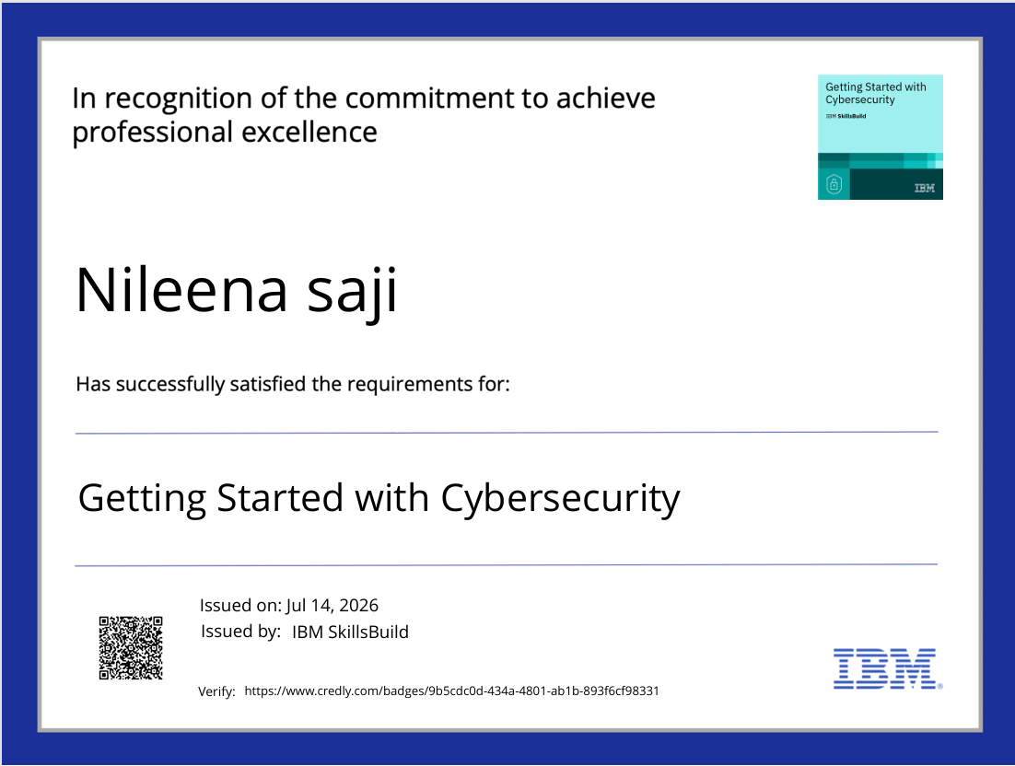
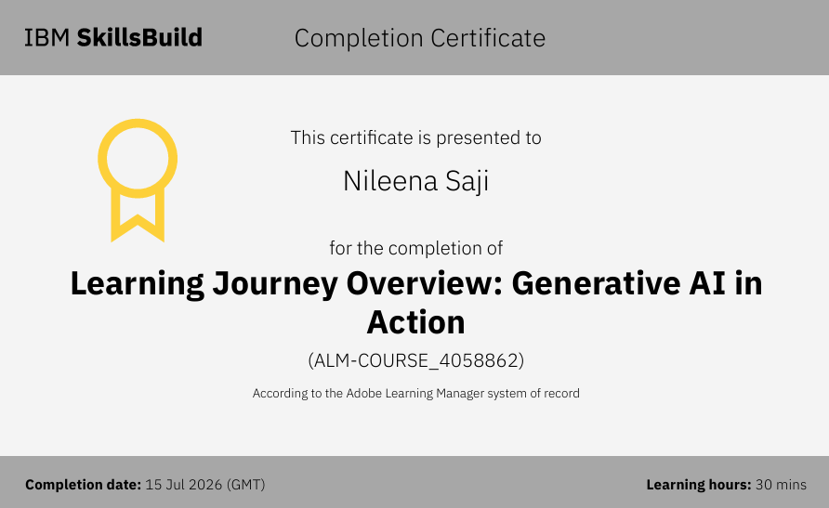
Certificates Earned:

Slide 13
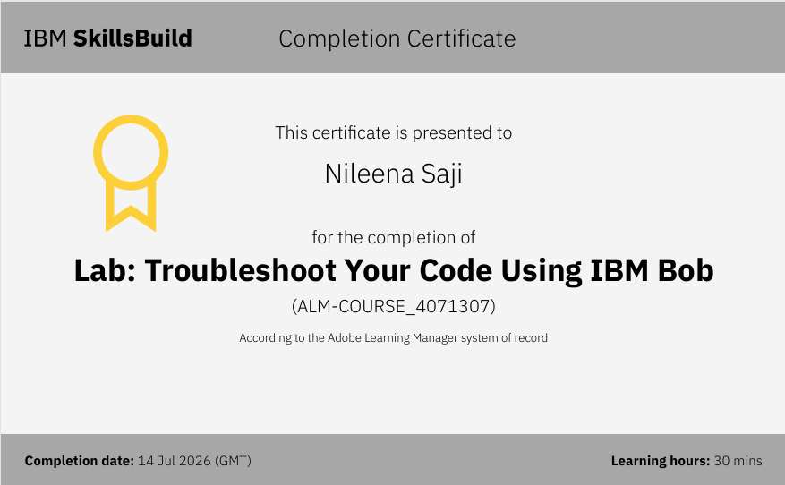
Certificates Earned:​

Slide 14


